Slide 1
RSHE – the future
Marriott Primary School

Slide 2
We recognise…
The role of parents in the development of their children’s understanding about relationships is vital. Parents are the first teachers of their children. They have the most significant influence in enabling their children to grow and mature and to form healthy relationships.

Slide 3
New government guidance states..
We want all children to grow up healthy, happy, safe, and able to manage the challenges and opportunities of modern Britain. That is why, from September 2020, all primary age children will be taught Relationships and Health Education.

Slide 4
What is covered…
These subjects are designed to equip your child with the knowledge to make informed decisions about their:
Wellbeing – physical and mental
Health
Relationships with other children and adults
Developing person attributes needed – honesty, kindness, humility, generosity, trustworthiness and a sense of justice
Preparing them for a successful adult life
These subjects as part of a comprehensive programme and through a whole school approach, can support the safeguarding of your child(ren).
The world for all young people looks very different from the way it did 20 years ago when this curriculum was last updated – these changes bring the content into the 21st century, so that it is relevant for your child.

Slide 5
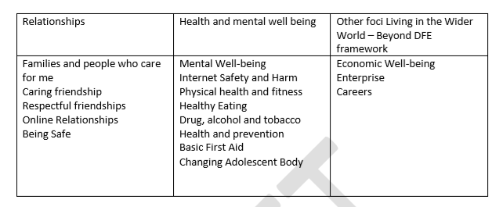
Provision will cover…
Main focus of tonight

Slide 6
Timeline
Worked on language and curriculum content
Small group of parents already met and discussed things
Talking to you tonight
Launch the Sex and Relationship element in the Summer term 2020
Full curriculum in Autumn 2020

Slide 7
Next steps…
Around the room are units of work about SRE – take a look
Vocabulary is on the walls and available to take away
Ask yourself – are you happy for your child to learn about this?

